Slide 1
Sampling
UAPP 702
Research Methods for Urban & Public Policy
Based on notes by Steven W. Peuquet, Ph.D.

Slide 2
Why do sampling?
To learn about the characteristics of a group of people or objects without having to collect information about all of the people or objects of interest.
To save money and time.
To increase internal validity. Use of multiple data collectors or the passage of large amounts of time can negatively impact internal validity (and there is no way of determining how much of a problem this creates). Well conducted samples can actually be more accurate than collecting the desired data from all of the people or objects of interest.

Slide 3
In Class Exercise
This exercise will demonstrate the power of random sampling. It involves the following steps:
A survey question will be distributed to everyone in class asking for your position on an important current issue.
All the responses will be tabulated.
A random sample of the responses will be drawn.
The results of the sample will be compared to the results from the universe of people in class.

Slide 4
In Class Exercise
Survey Question:
Right now, how are you feeling about your chances of obtaining the kind of job you would like after you graduate?
I’m feeling more positive than negative.
I’m feeling more negative than positive.
ID Number ____

Slide 5
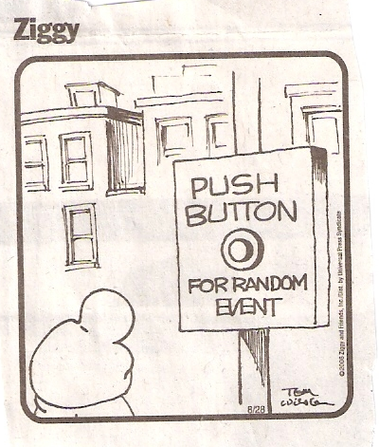
Obtaining Random Numbers and Tallying the Results
Check out “Random.org”
Go here for “Vote Tally Sheet”

Slide 6
Types of Sampling
The following three types of samples are based on the use of probability theory. These types of samples increase external validity (i.e., they produce results which can to some extent be generalized to a broader group).
Simple random sample
Stratified random sample
Cluster samples

Slide 7
Non-Probability Samples
Other types of samples are not based on probability theory, do not produce external validity, and hence are very risky to use: quota, purposive, snowball, and haphazard.

Slide 8
Two ways of making a probability sample more representative of the population being studied:
Make sure that every unit picked for the sample has the same chance of being picked as any other unit (randomness).
Increase the sample size (less important that (1) above).

Slide 9
Proper Size of the Sample
Factors that affect what the size of the sample needs to be:
The heterogeneity of the population (or strata or clusters) from which the units are chosen.
How many population subgroups (strata) you will deal with simultaneously in the analysis.
How accurate you want your sample statistics (parameter estimates) to be.
How common or rare is the phenomenon you are trying to detect.
How much money and time you have.

Slide 10
Calculating Sample Size
X²NP(1-P)
n = ________________
C²(N-1)+X²P(1-P)
Where:
n = the required sample size
X² = is the chi-square value for 1 degree of freedom at some desired probability level
N = is the size of the population universe (which gets more important as N gets smaller)
P = is the population parameter of the variable (set=.5 which is the worst case scenario, meaning maximally heterogeneous for a dichotomous variable)
C = the chosen confidence interval
Important note: This formula is good for dichotomous variable (yes/no type variable), not more complex variables.

Slide 12
Example: Perception of Low and Moderate Income People About Welfare Reform
What is the sample size (n) necessary to determine with 95% confidence what proportion of low- and moderate-income people in Delaware feel that welfare reform is a good thing, with a confidence interval (measurement error) of plus or minus 3%?

Slide 13
Using the formula previously described:
Where:
X² = 3.841 N = 148,429 P = .5 (1-P) = .5 C = .03
Plugging these values into the formula produces a required sample size (n) of 1,059. For this example go here to see a table showing the calculated required sample sizes (n) under different scenarios.

Slide 14
Stratified Sampling
Is done whenever it is likely than an important subpopulation will be under represented in a simple random sample.
Must know independent variables upon which to stratify
Must know the sizes of the strata subpopulations
Is complex and more costly
Each strata has it's own sampling error. But the aggregate sampling error of the total population is reduced.
There is proportionate and disproportionate random sampling

Slide 15
Cluster Sampling
Is a way to sample a population when there is no convenient lists or frames (e.g., homeless in shelters or soup kitchens).

Slide 16
Self-Selection Bias
Is caused by the unit of observation (e.g., person) choosing whether or not to be a respondent in a survey.
If the self-selection process itself is random, it will not compromise the randomness of the selection process.
If the self-selection process is not random (is systematic), it will compromise the randomness of the selection process.

Slide 17
Using Sampling to Create Control & Experimental Groups
As we’ve previously discussed in this course, sampling is a very important tool for creating control groups and experimental groups in experimental research designs.
To create two groups, you would simply draw two separate samples from the same universe, using a sample size that is adequate to produce the level of comparability (precision) desired.

Slide 18
Using Sampling to Create Control & Experimental Groups
If you have a “before/after” research design, the control group consists of units of observation randomly selected before a new program or policy was implemented (i.e., the “treatment’), and the experimental group consists of units of observation randomly selected after the new program or policy was implemented. Example: Affect of the switch from the use of coupons to the use of debit cards in the Food Stamp Program on stigma.

Slide 19
Using Sampling to Create Control & Experimental Groups
Important Points!
If:
A = the universe of units of observation you are studying;
B = a properly drawn random sample of the universe A;
then: B will be comparable (representative) of A.
Further, if:
C = another properly drawn random sample of the universe A; then: C will be comparable to (representative of) A, and C will also be comparable (representative of) B. The two samples (one a control group and one an experimental group) are comparable!

